Slide 1
LED Fundamentals
Understand your specifications

Slide 2
About color

Slide 3
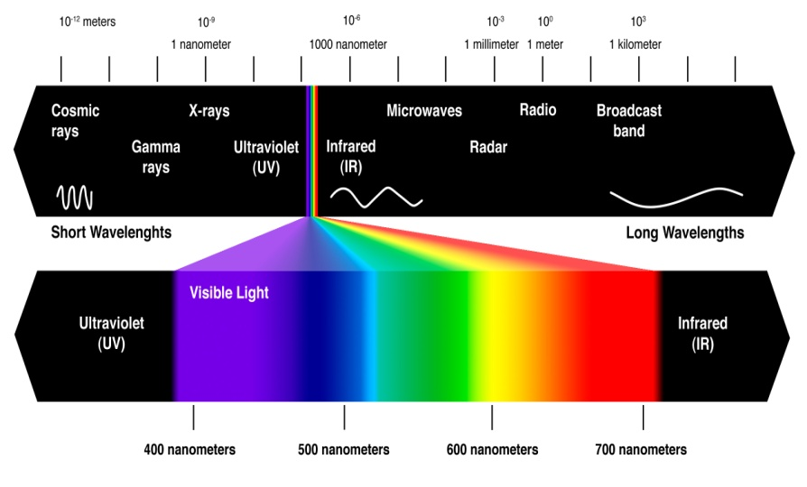
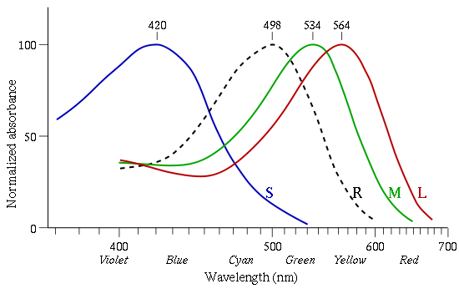
About color
Color is about wavelengths
Visible light is a small region of the electromagnetic spectrum
Wavelengths range from 400nm (violet) to 700nm (red)
Seeing color is about perception
The eye absorbs the light by several receptors
The brain translates these ‘measurements’ in color sensation
The eye has 2 types of receptors
Rods are sensitive to low levels of light and do not pickup color
Cones provide us the ability to sense color and resolve fine detail
L: Long wavelenght or called Red (peak sensitivity at 564nm)
M: Mid wavelength or called Green (peak sensitivity at 534nm)
S: Short wavelenght or called Blue (peak sensitivity at 420nm)

Slide 4
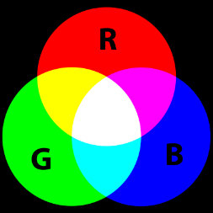
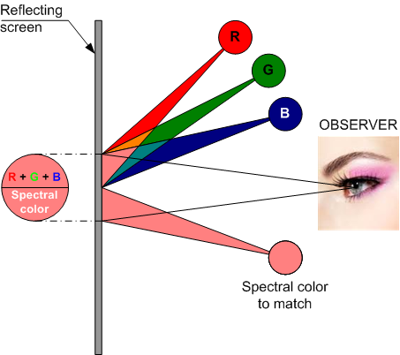
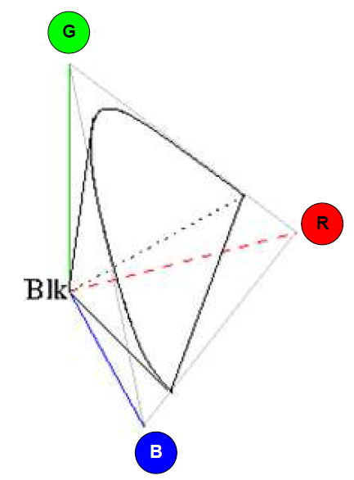
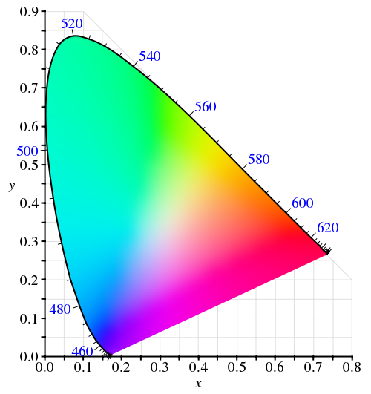
About color
A color can be created by mixing 3 primary colors
Additive mixing of several wavelenghts can give the same perception as a pure color of one single wavelenght
The exact quantity of Red, Green and Blue (the primaries) needed to create another pure color has been measured by means of an experiment
The result is the CIE 1931 Color Space
Experiment
Mapping of RGB for each color
CIE 1931 color space

Slide 5
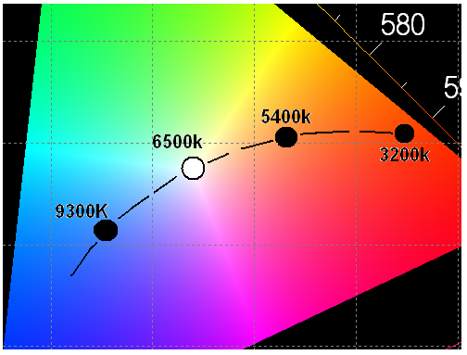
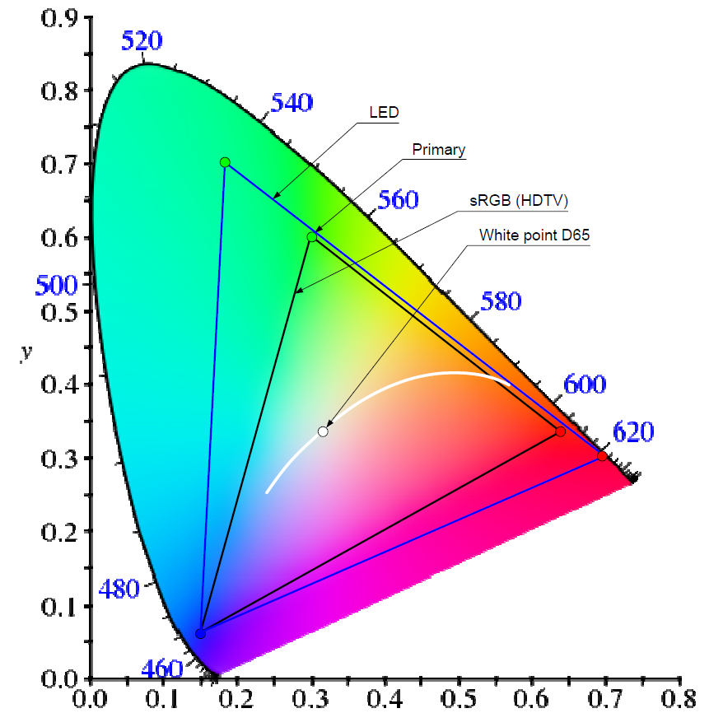
About color
The CIE 1931 color space
This shows a full plot of all colors that the human eye can see
The outer curved boundary is the monochromatic locus
The White Point D65 is white at color temperature of 6500K
A color gamut is a section
The boundaries are defined by its primary colors
Several gamuts exist, such as HDTV, NTSC, EBU, LED, ...
CRT: depending on the colors of the phosphors of the monitor
HDTV: uses the sRGB color gamut based on CRT
LED: depending on the colors of the Red, Green and Blue led used
The larger the gamut, the more saturated the colors
A device that is able to reproduce the entire visible color space is still an unrealized goal
LED screens have a very large gamut => more saturation
That’s why LED is sometimes preferred over projection

Slide 6
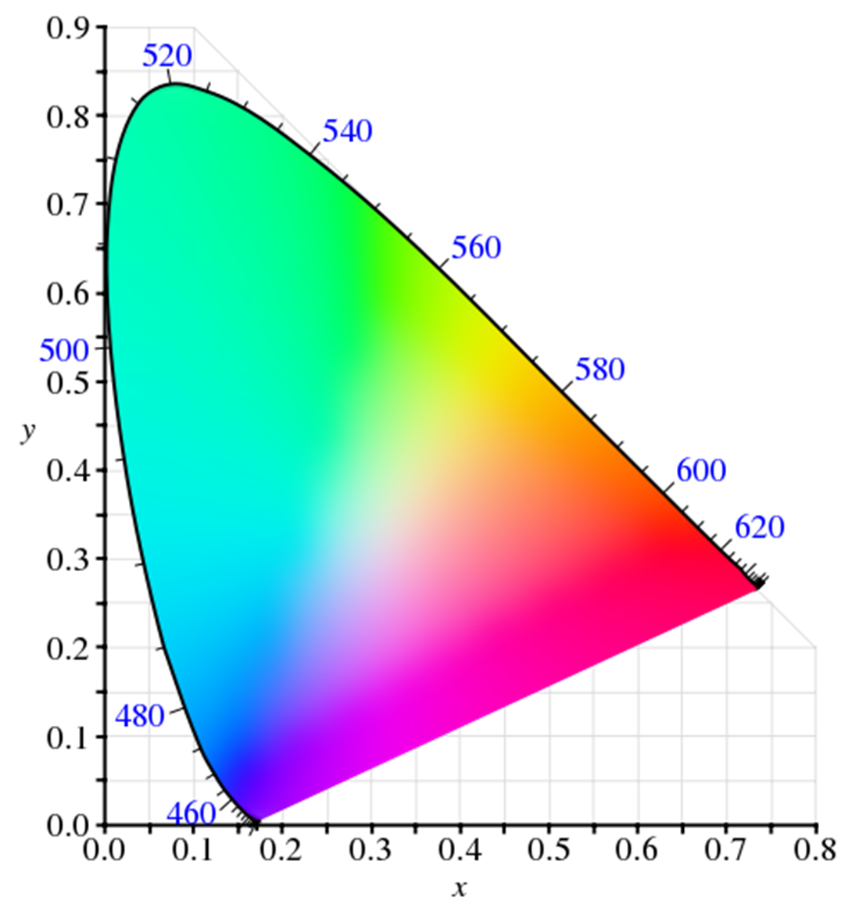
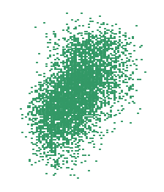
About color
The color of each pixel is defined by
Amount of light emitted by the Red LED (r)
Amount of light emitted by the Green LED (g)
Amount of light emitted by the Blue LED (b)
But each LED has some tolerances on
Wavelength
(x,y) coordinates
Luminous Intensity
This means that for another pixel, with the same values of (r), (g) and (b) a different color might be shown
The solution to this problem is
Reduce tolerances by carefully selecting the LEDs
This is also called ‘ranking’ or ‘binning’
The narrower the selection is, the more expensive the LEDs are
Calibration
G₁
Color difference
G₂
g
R₂
r
R₁
b
B₂
G₁
G₂
B₁
Adding some blue
Adding some red
Bring all LEDs of same color together
Calibrated Green

Slide 7
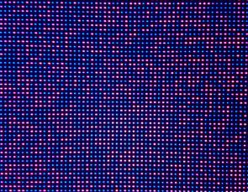

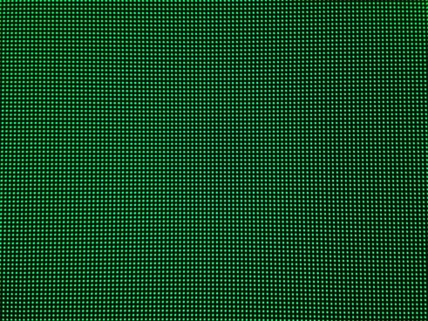
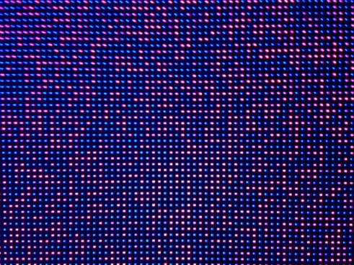
About color
You would be surprised how much Blue and Red is contained in Green

Slide 8
About specifications

Slide 9
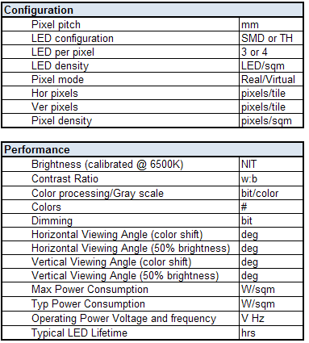
Basic specifications of a LED product
Understanding the specifications is key !!!
Comparing with different type of products
Determining the correct product type for an application
Giving the correct explication to customers
Specifications can be misleading
Interpretations might differ from vendor to vendor
Understanding the specs = know what you talk about
After all... it’s no rocket science

Slide 10
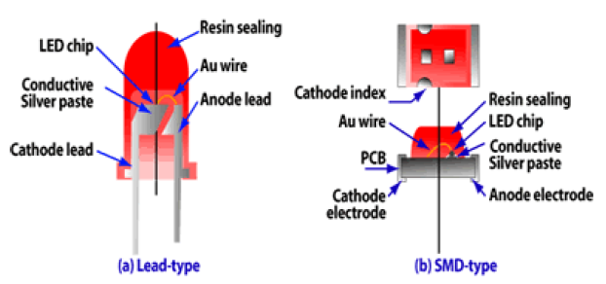
Configuration – SMD or TH
Configuration
 | Pixel pitch | mm
 | LED configuration | SMD or TH
 | LED per pixel | 3 or 4
 | LED density | LED/sqm
 | Pixel mode | Real/Virtual
 | Hor pixels | pixels/tile
 | Ver pixels | pixels/tile
 | Pixel density | pixels/sqm
2 types of LEDs
Through-Hole (TH)
Surface Mounted Diode (SMD)
TH
At least one LED per color (Red, Green, Blue)
Sometimes a 4th or even 5th LED is added to:
Increase brightness
Allow virtual pixel mode
Create better color reproduction (depends on LED brand)
Used for larger pitches (>10mm) -> Outdoor applications
SMD
3 colors in one package
Allows wider viewing angles (less color shift)
Allows shorter viewing distances (color mixing happens earlier)
Used for smaller pitches (<10mm) -> Indoor applications
“Black silicon resin” or “Black package” to increase contrast
TH
SMD

Slide 11
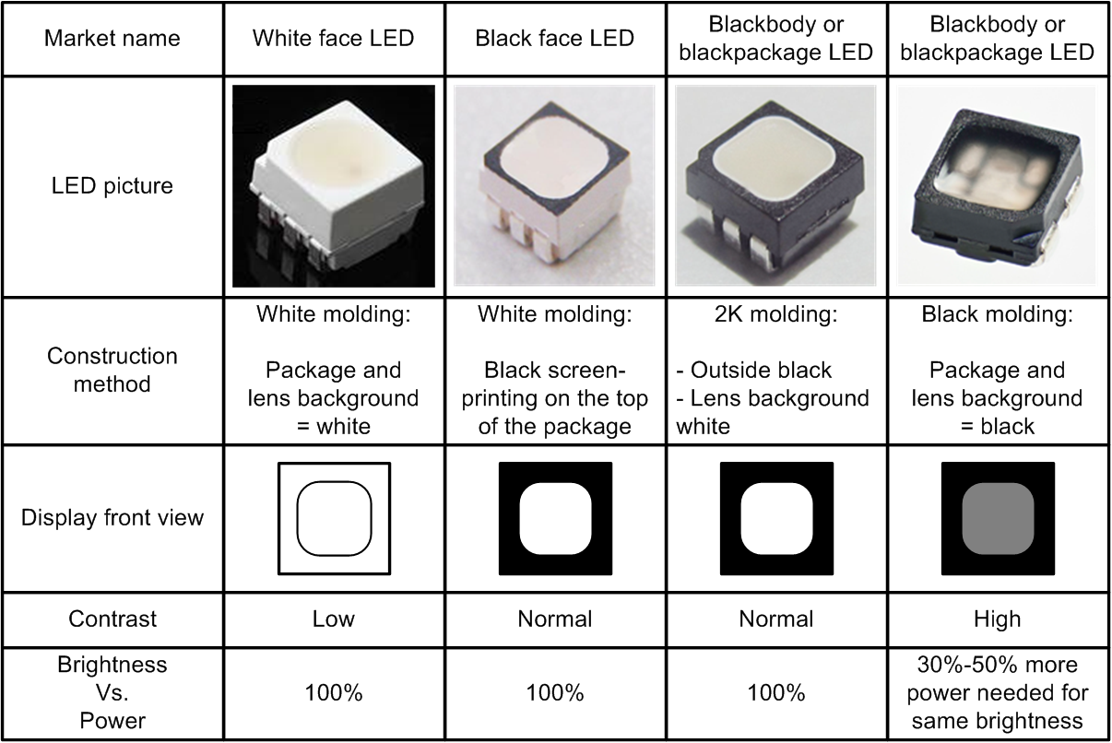
Configuration – “Black” LED
Configuration
 | Pixel pitch | mm
 | LED configuration | SMD or TH
 | LED per pixel | 3 or 4
 | LED density | LED/sqm
 | Pixel mode | Real/Virtual
 | Hor pixels | pixels/tile
 | Ver pixels | pixels/tile
 | Pixel density | pixels/sqm
Barco to be the first to use “Black LED” (BK)

Slide 12
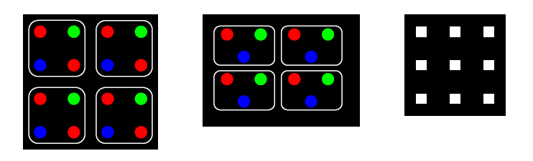
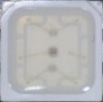

Configuration – Pixel density
Configuration
 | Pixel pitch | mm
 | LED configuration | SMD or TH
 | LED per pixel | 3 or 4
 | LED density | LED/sqm
 | Pixel mode | Real/Virtual
 | Hor pixels | pixels/tile
 | Ver pixels | pixels/tile
 | Pixel density | pixels/sqm
“Pixel” <> “LED”
LED refers to the physical component that creates a pixel
Pixel is the smallest component of the image
In case of TH: pixel = multiple LEDs
In case of SMD: pixel = LED
Different layouts of TH pixels
3 LEDs (R, G, B) -> most common
4 LEDs (R, R, G, B) –> example V10v
Other formats might be possible
Different layouts of SMD pixels
RGB in line
RGB in ‘mickey mouse’ pattern
Density
LED-density = LEDs/sqm
Pixel-density = Pixels/sqm
In case of TH, LED-density > pixel-density
TH RRGB
TH RGB
SMD

Slide 13
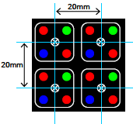
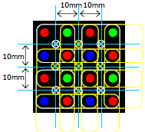
Configuration – Pixel pitch
Configuration
 | Pixel pitch | mm
 | LED configuration | SMD or TH
 | LED per pixel | 3 or 4
 | LED density | LED/sqm
 | Pixel mode | Real/Virtual
 | Hor pixels | pixels/tile
 | Ver pixels | pixels/tile
 | Pixel density | pixels/sqm
The “pixel pitch” is the distance between pixels
Center to Center
Normally: vertical = horizontal
Resolution of LED-screen
“Horizontal pixels per tile” x horizontal tiles
“Vertical pixels per tile” x vertical tiles
Virtual pixel mode
Combining LEDs of adjacent pixels to create additional pixels
Increases the resolution of LED screen...
without adding LEDs
without increasing power consumption
Usage
Excellent for moving images
Not recommended for still images (<sharpness)
Example V10v -> 20 mm real / 10mm virtual

Slide 14
Configuration – Pixel pitch
Configuration
 | Pixel pitch | mm
 | LED configuration | SMD or TH
 | LED per pixel | 3 or 4
 | LED density | LED/sqm
 | Pixel mode | Real/Virtual
 | Hor pixels | pixels/tile
 | Ver pixels | pixels/tile
 | Pixel density | pixels/sqm
Pixel pitch determines minimum viewing distance
Minimum viewing distance ‘= pitch in meter’
Relates to color mixing – all leds in a pixel merge in to a single colored pixel
Is shorter for SMD than TH
Optimal Viewing Distance ‘= pitch in meter x 2’
Where viewer can not see any pixelization
Is shorter for TH than SMD
Screen size determines maximum viewing distance
Maximum Viewing Distance ‘= vertical size x 30’
Is rather subjective – related to screen size and readablility
Readability means that the type of content is important (still or moving images, text)
Rules of thumb!!!

Slide 15
Configuration – Pixel pitch
Configuration
 | Pixel pitch | mm
 | LED configuration | SMD or TH
 | LED per pixel | 3 or 4
 | LED density | LED/sqm
 | Pixel mode | Real/Virtual
 | Hor pixels | pixels/tile
 | Ver pixels | pixels/tile
 | Pixel density | pixels/sqm
Size of screen when displaying text
Depends on number of lines to be displayed
Be careful with virtual pixels – use real pixels to calculate

Slide 16
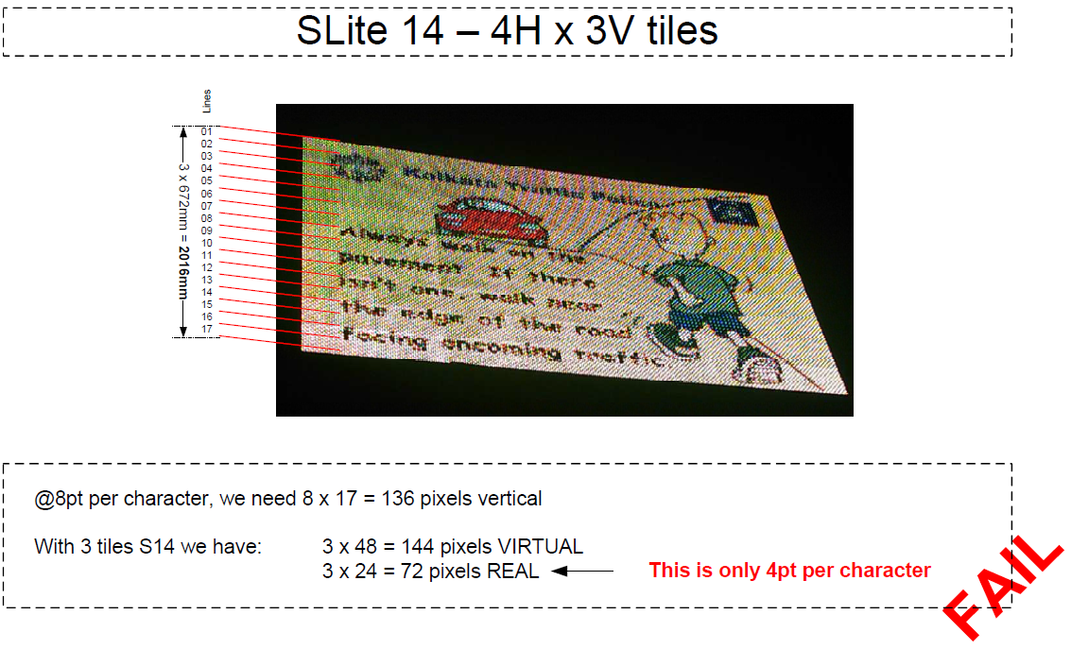
Configuration – Pixel pitch – case study
Configuration
 | Pixel pitch | mm
 | LED configuration | SMD or TH
 | LED per pixel | 3 or 4
 | LED density | LED/sqm
 | Pixel mode | Real/Virtual
 | Hor pixels | pixels/tile
 | Ver pixels | pixels/tile
 | Pixel density | pixels/sqm
Displays with text require accurate ‘pitch-study’
Scoreboards
Information displays

Slide 17
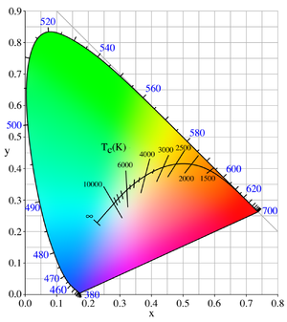
Performance - Brightness
Performance
 | Brightness (calibrated @ 6500K) | NIT
 | Contrast Ratio | w:b
 | Color processing/Gray scale | bit/color
 | Colors | #
 | Dimming | bit
 | Horizontal Viewing Angle (color shift) | deg
 | Horizontal Viewing Angle (50% brightness) | deg
 | Vertical Viewing Angle (color shift) | deg
 | Vertical Viewing Angle (50% brightness) | deg
 | Max Power Consumption | W/sqm
 | Typ Power Consumption | W/sqm
 | Operating Power Voltage and frequency | V Hz
 | Typical LED Lifetime | hrs
Brightness of LED-tile is expressed in NIT
Each LED generates a light output in candela
A pixel generates the combined light output of its (R, G, B) LEDs
Brightness is expressed in NIT: 1 NIT = 1 candela per sqm
Pixel density x cd/pixel = brightness in NIT
Each LED tile is factory calibrated
To eliminate the differences in brightness between seperate LEDs
To guarantee same color for each pixel (%R, %G, %B)
Barco uses “Narrow binning” LEDs -> highest quality
Color temperature is important parameter
Calibration is done at a color temperature of 6500K
The color temperature gives a normalized combination of R, G , B
Screen brightness is calibrated on site
The installation software alligns to the ‘weakest tile’
Without site calibration, tiles might be perceived brighter/darker

Slide 18
Performance – Contrast ratio
Performance
 | Brightness (calibrated @ 6500K) | NIT
 | Contrast Ratio | w:b
 | Color processing/Gray scale | bit/color
 | Colors | #
 | Dimming | bit
 | Horizontal Viewing Angle (color shift) | deg
 | Horizontal Viewing Angle (50% brightness) | deg
 | Vertical Viewing Angle (color shift) | deg
 | Vertical Viewing Angle (50% brightness) | deg
 | Max Power Consumption | W/sqm
 | Typ Power Consumption | W/sqm
 | Operating Power Voltage and frequency | V Hz
 | Typical LED Lifetime | hrs
Contrast ratio is ratio between white and black
White is created by emitting light
Black is created by blackness of tile surface
Black is more difficult to create then white
Depends on blackness of LEDs used
Depends on blackness of material between LEDs used
Depends on reflective behavior of material used
Depends on external light conditions
Contrast ratio to be measured at surounding light of 200 Lux
Barco’s louvre design acts as ‘light trap’
Reflected light is trapped to create darker surface
For elevated screens, short louvres improve viewing, but reduce contrast ratio
Better blackness reduces power consumption
Less emitted light needed for same contrast

Slide 19
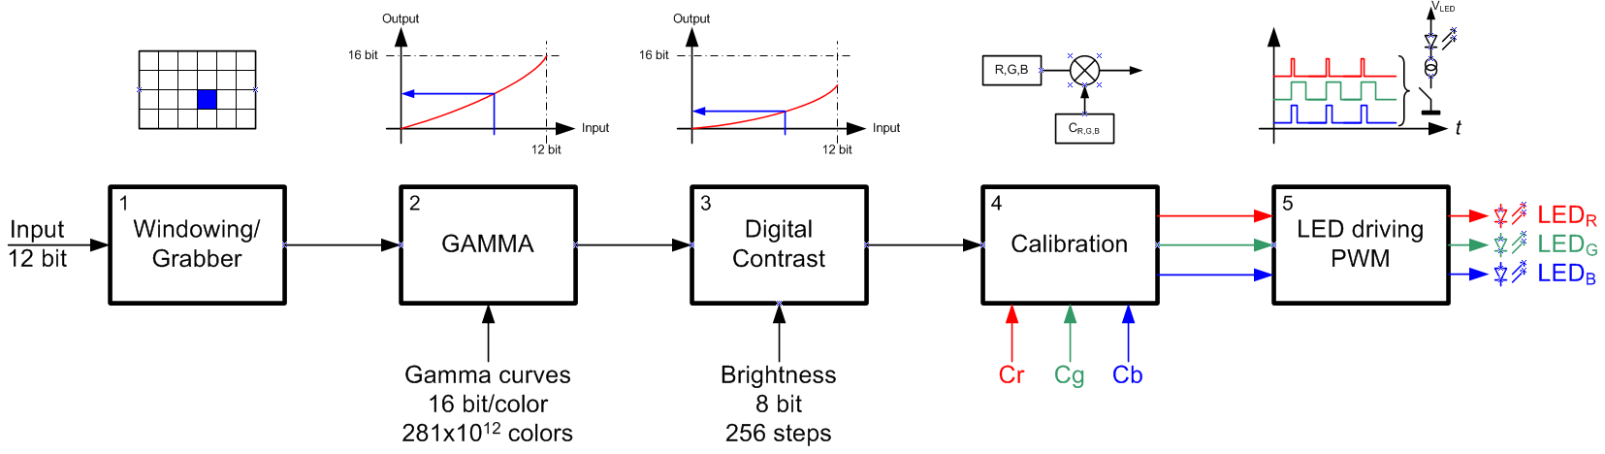
Performance – Processing
Performance
 | Brightness (calibrated @ 6500K) | NIT
 | Contrast Ratio | w:b
 | Color processing/Gray scale | bit/color
 | Colors | #
 | Dimming | bit
 | Horizontal Viewing Angle (color shift) | deg
 | Horizontal Viewing Angle (50% brightness) | deg
 | Vertical Viewing Angle (color shift) | deg
 | Vertical Viewing Angle (50% brightness) | deg
 | Max Power Consumption | W/sqm
 | Typ Power Consumption | W/sqm
 | Operating Power Voltage and frequency | V Hz
 | Typical LED Lifetime | hrs
Typical LED tile building blocks
Windowing/Grabber to take a part of the image
Gamma correction to adjust unlinearities between input and output
Digital Contrast to control the overall brightness
Calibration to guarantee color uniformity
LED driving PWM (Pulse Width Modulation) to drive the brightness of each individual LED

Slide 20
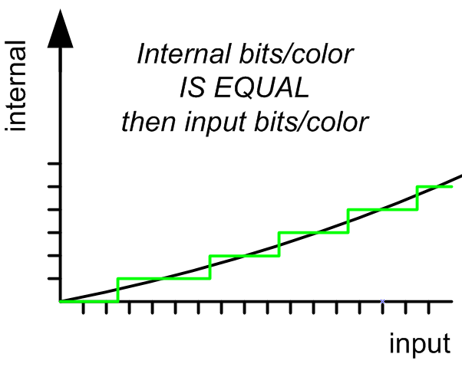
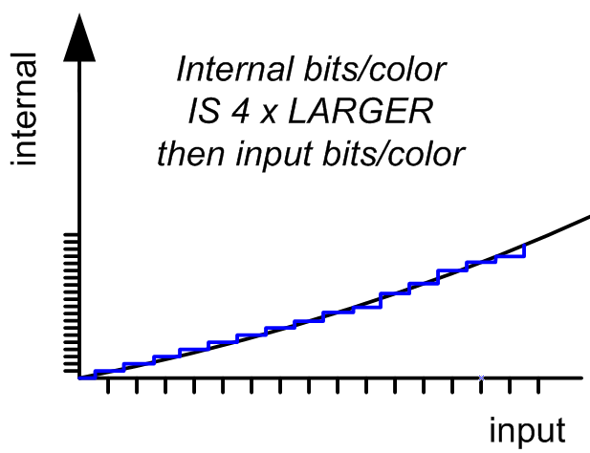
Performance – Processing
Performance
 | Brightness (calibrated @ 6500K) | NIT
 | Contrast Ratio | w:b
 | Color processing/Gray scale | bit/color
 | Colors | #
 | Dimming | bit
 | Horizontal Viewing Angle (color shift) | deg
 | Horizontal Viewing Angle (50% brightness) | deg
 | Vertical Viewing Angle (color shift) | deg
 | Vertical Viewing Angle (50% brightness) | deg
 | Max Power Consumption | W/sqm
 | Typ Power Consumption | W/sqm
 | Operating Power Voltage and frequency | V Hz
 | Typical LED Lifetime | hrs
“16 bits per color”
Each color (LED) has an accuracy of 16 bits
16 bits = 2¹⁶ = 65536 different combinations
0 = no light = black
65536 = full brightness (R, G or B)
R x G x B = 281000000000000 or 281 trillion combinations
But why 16 bits if video input is < 16 bits?
Example: Blue Ray player only offers 8 bits/color
Higher internal bits/color results in better color reproduction
Especially for “low lights” → “flat” side of gamma curve
Inaccurate
color reproduction
Accurate
color reproduction

Slide 21
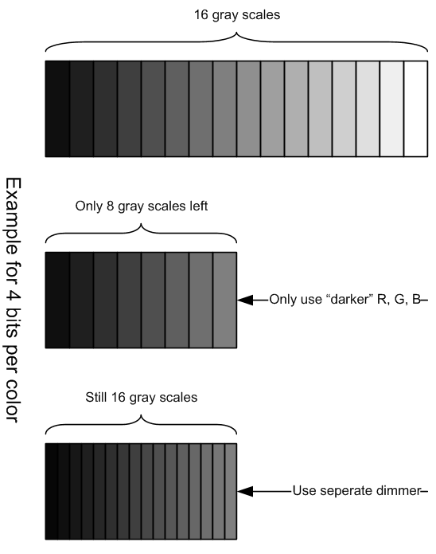
Performance – Processing
Performance
 | Brightness (calibrated @ 6500K) | NIT
 | Contrast Ratio | w:b
 | Color processing/Gray scale | bit/color
 | Colors | #
 | Dimming | bit
 | Horizontal Viewing Angle (color shift) | deg
 | Horizontal Viewing Angle (50% brightness) | deg
 | Vertical Viewing Angle (color shift) | deg
 | Vertical Viewing Angle (50% brightness) | deg
 | Max Power Consumption | W/sqm
 | Typ Power Consumption | W/sqm
 | Operating Power Voltage and frequency | V Hz
 | Typical LED Lifetime | hrs
Dimming
There are 2 ways to dim (reduce brightness)
Only use the “darker” R, G and B
This also reduces the combinations for each color
Color steps will become visible at low brightness
Use a seperate dimming control
Even at low brightness, all combinations for each color are possible
Barco uses a seperate dimming control of 8 bits
8 bits = 2⁸ = 256 steps = 0,4% per step
Human eye doesn’t see differences less than 2%

Slide 22
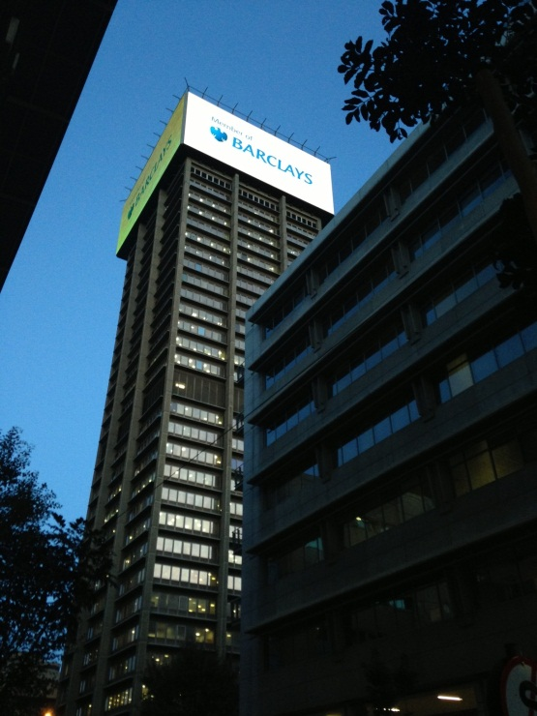
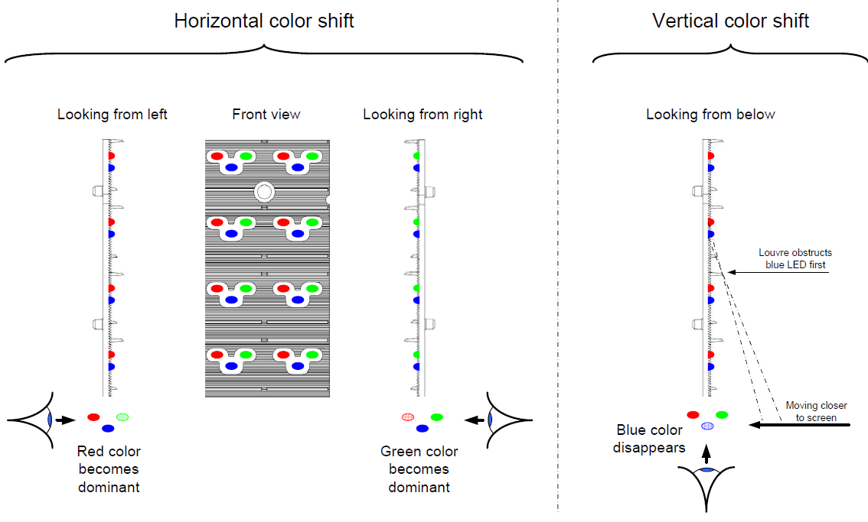
Performance – Viewing angle 1
Performance
 | Brightness (calibrated @ 6500K) | NIT
 | Contrast Ratio | w:b
 | Color processing/Gray scale | bit/color
 | Colors | #
 | Dimming | bit
 | Horizontal Viewing Angle (color shift) | deg
 | Horizontal Viewing Angle (50% brightness) | deg
 | Vertical Viewing Angle (color shift) | deg
 | Vertical Viewing Angle (50% brightness) | deg
 | Max Power Consumption | W/sqm
 | Typ Power Consumption | W/sqm
 | Operating Power Voltage and frequency | V Hz
 | Typical LED Lifetime | hrs
Viewing angle (color shift)
Angle at which the color of the screen changes
Because of LEDs being covered by other LEDs
Because louvres obstructing some LEDs
Left and Right will always be equal (120° = +60°/-60°)
Up (+) will in most cases be smaller than down (-)
Color shifts to green

Slide 23
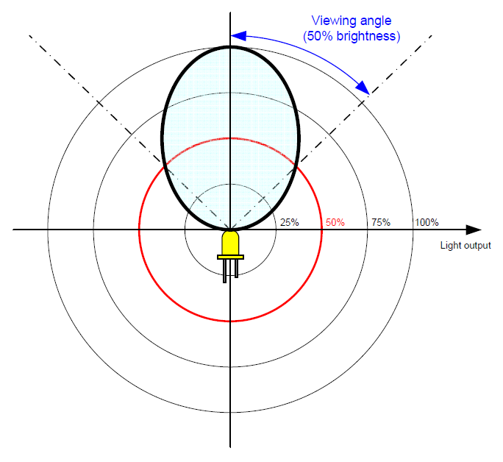
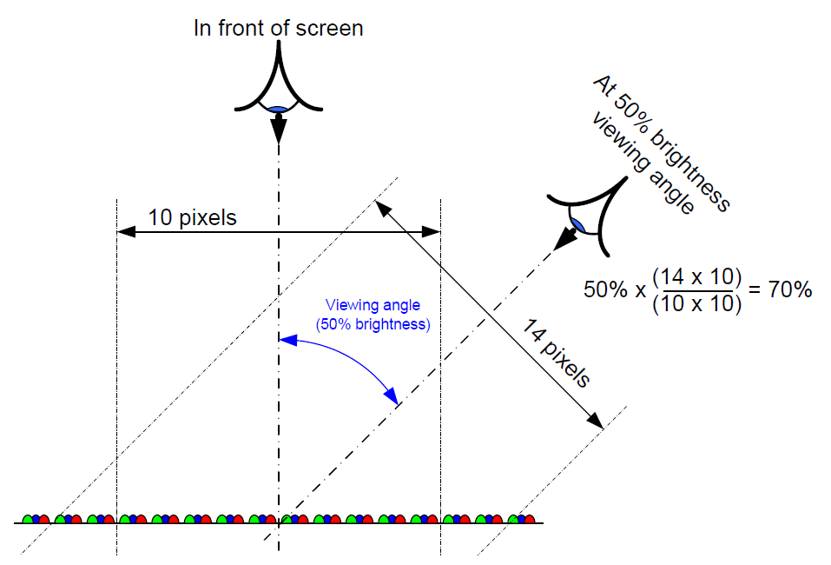
Performance – Viewing angle 2
Performance
 | Brightness (calibrated @ 6500K) | NIT
 | Contrast Ratio | w:b
 | Color processing/Gray scale | bit/color
 | Colors | #
 | Dimming | bit
 | Horizontal Viewing Angle (color shift) | deg
 | Horizontal Viewing Angle (50% brightness) | deg
 | Vertical Viewing Angle (color shift) | deg
 | Vertical Viewing Angle (50% brightness) | deg
 | Max Power Consumption | W/sqm
 | Typ Power Consumption | W/sqm
 | Operating Power Voltage and frequency | V Hz
 | Typical LED Lifetime | hrs
Viewing angle (50% brightness)
Angle at which the output of the LED is reduced to 50%
It does not mean that brightness of SCREEN is reduced to 50%
At an angle, more LEDs/sqm are seen
Brightness = cd/LED (reduced) x LED/sqm (increased)
In the below example, brightness still 70% at angle of 50% brightness

Slide 24
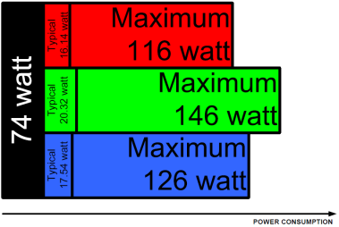
Performance – Power consumption
Performance
 | Brightness (calibrated @ 6500K) | NIT
 | Contrast Ratio | w:b
 | Color processing/Gray scale | bit/color
 | Colors | #
 | Dimming | bit
 | Horizontal Viewing Angle (color shift) | deg
 | Horizontal Viewing Angle (50% brightness) | deg
 | Vertical Viewing Angle (color shift) | deg
 | Vertical Viewing Angle (50% brightness) | deg
 | Max Power Consumption | W/sqm
 | Typ Power Consumption | W/sqm
 | Operating Power Voltage and frequency | V Hz
 | Typical LED Lifetime | hrs
Power consumption of LED tile is combination of
Power for controller, ventilators, etc... -> ‘Black power’
Power for LEDs -> R, G, B power
Even when not emitting light, the tile consumes power
Usage of the power consumption specifications
Maximum power consumption
Used to calculate power provisions
Used to calculate LED-tiles/power-circuit
Typical power consumption
Used to calculate power provisions
Used to calculate LED-tiles/power-circuit
Typical power consumption is only an estimate
Depends on image content (white consumes more than black)
Depends on brightness of screen
Using automatic brightness control might significantly reduce power consumption
Barco LiveDots is known as ‘green product’
Example: TF-20

Slide 25
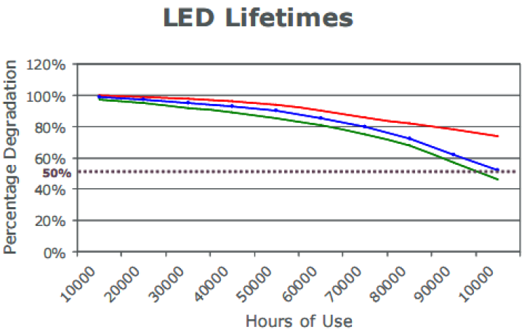
Performance – Typical LED Lifetime
Performance
 | Brightness (calibrated @ 6500K) | NIT
 | Contrast Ratio | w:b
 | Color processing/Gray scale | bit/color
 | Colors | #
 | Dimming | bit
 | Horizontal Viewing Angle (color shift) | deg
 | Horizontal Viewing Angle (50% brightness) | deg
 | Vertical Viewing Angle (color shift) | deg
 | Vertical Viewing Angle (50% brightness) | deg
 | Max Power Consumption | W/sqm
 | Typ Power Consumption | W/sqm
 | Operating Power Voltage and frequency | V Hz
 | Typical LED Lifetime | hrs
Light output of LEDs gradually decreases
Lifetime specification
Light output drops below 50%
Used at typical brightness (+/- 30% of maximum)
Barco commonly specifies 100000 hrs
That is 11,4 years when used 24/7
In most cases this far exceeds warranty expectations

Slide 26
Some applications

Slide 27
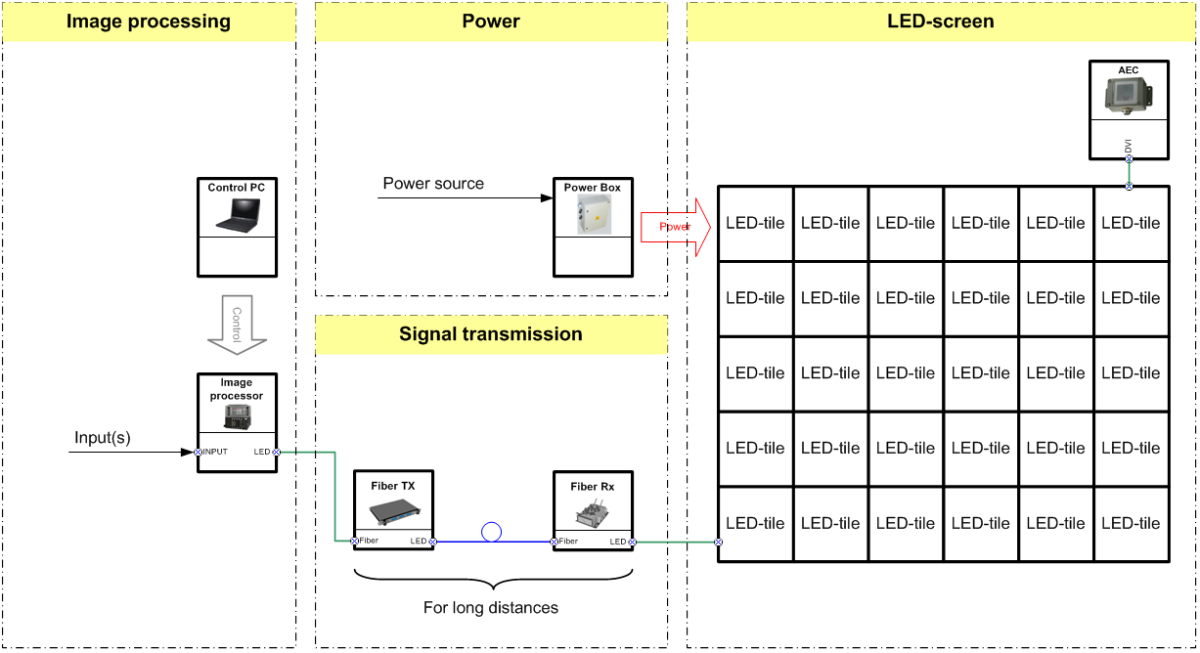
LED-screen – Basic

Slide 28
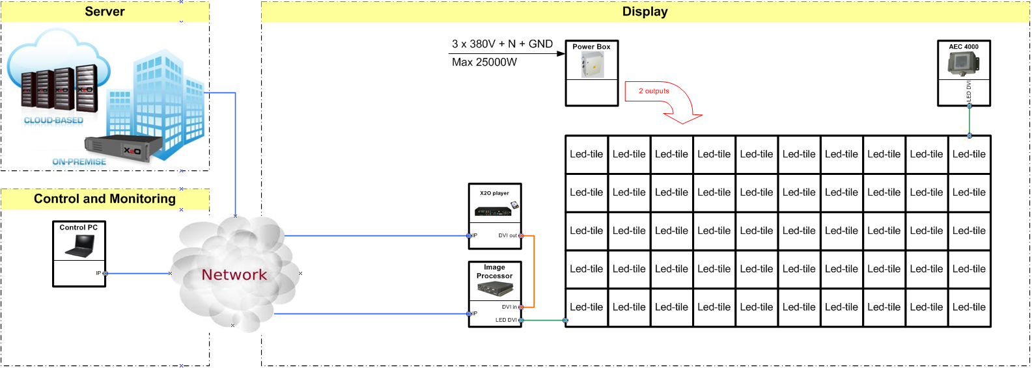
LED-screen – DOOH
Combination of a LED Image Processor and an X2O player results in very compact design
All content loaded (buffered) on HardDisk of X2O player
Direct connection to IP-network (through customer network)
Remote Management System allows management of several screens
AEC allows 24/7 operation in light-sensitive environments (roads, city centers, ...)

Slide 29
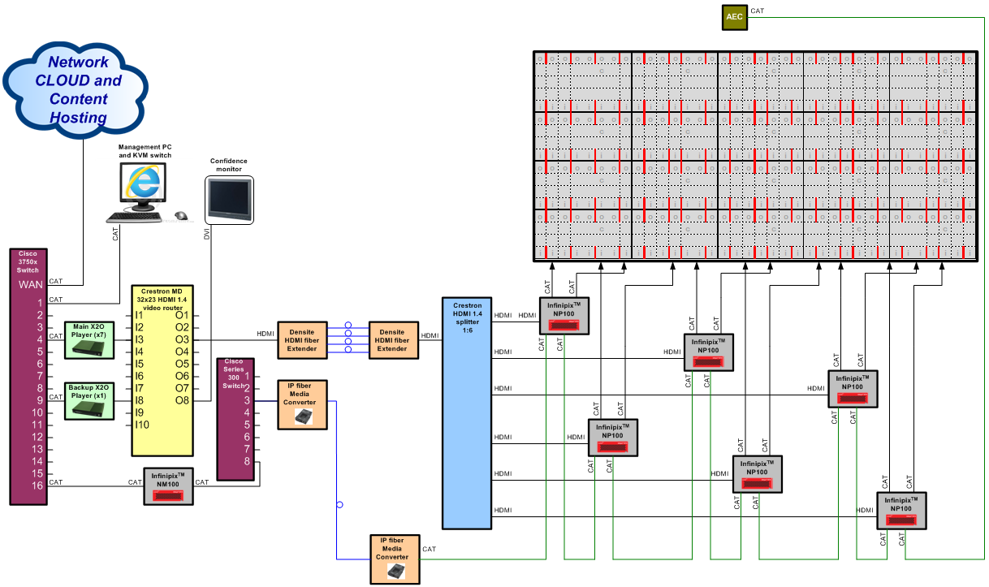
LED-screen – Multiple large screens

Slide 30
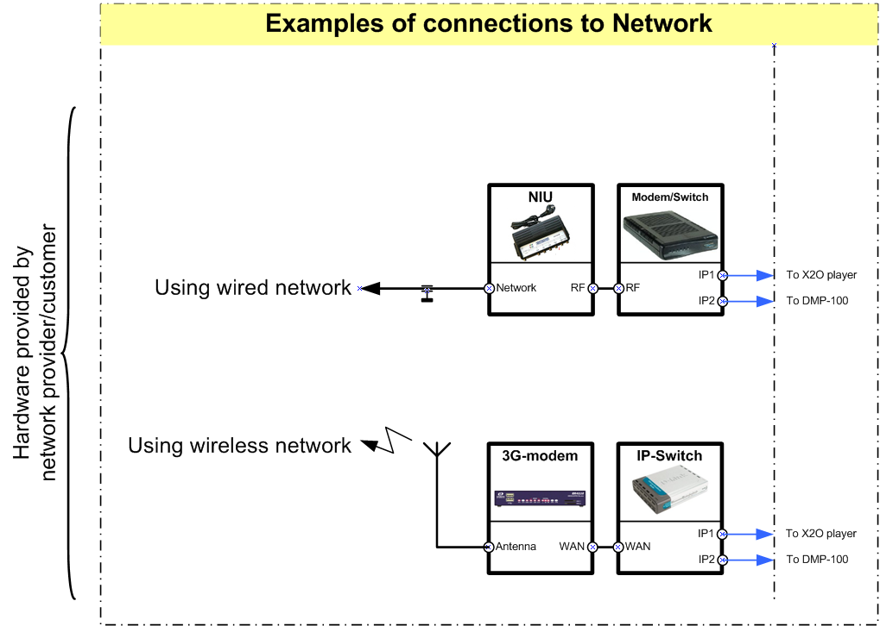
LED-screen – DOOH – Connection to network
Network connection can not be provided by Barco
Examples (see left images)
Telenet home network
ClearChannel/Cemusa 3G
Fiber also possible
although less common for multiple DOOH screens

Slide 31
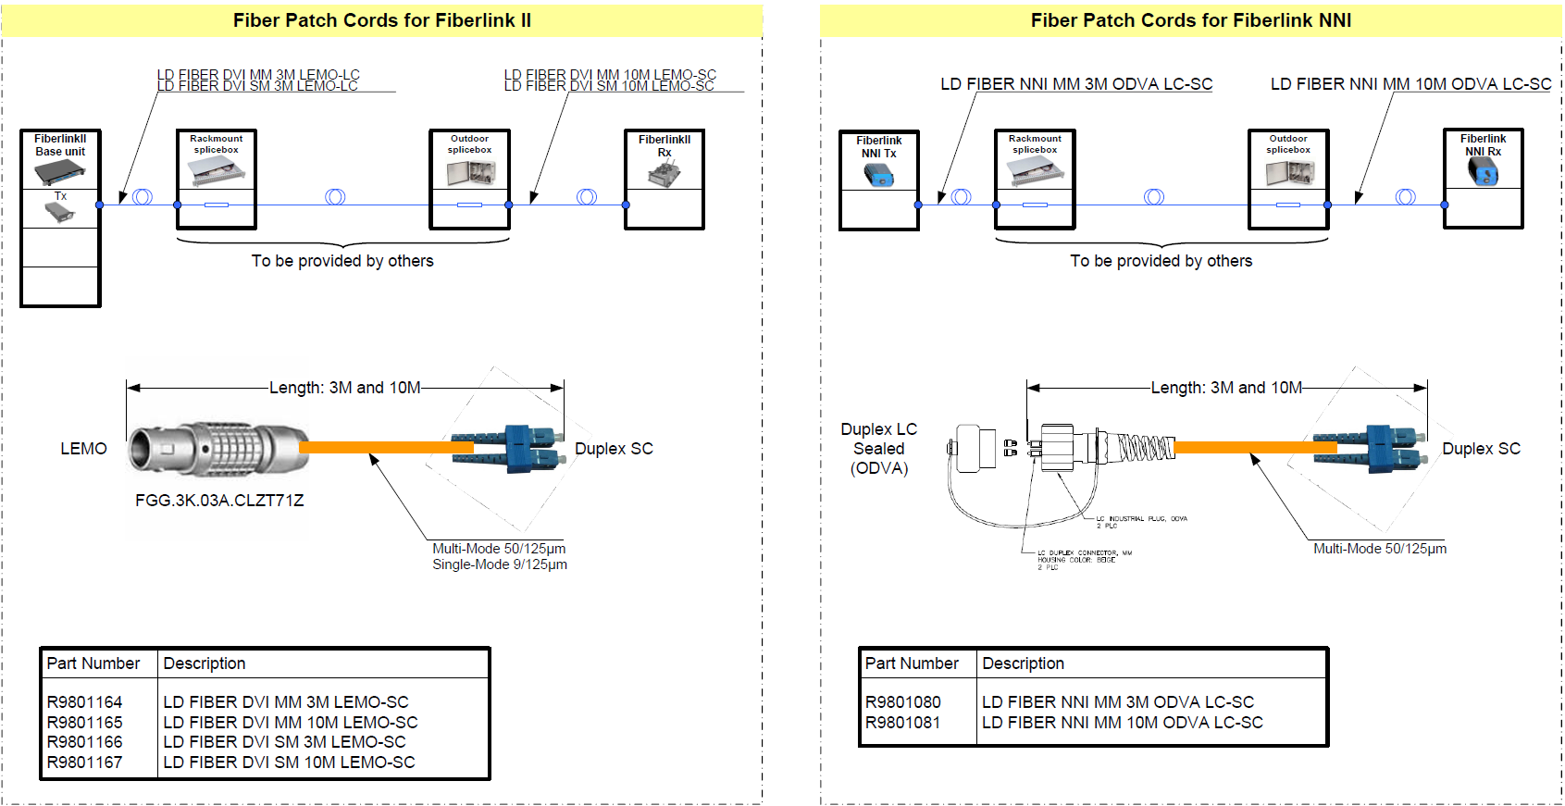
Signal transmission: Fiber using patch cables

Slide 32
Image processing: Multiple screens with 1 input/1 output
This approach can be cost saver for
Double sided screens
Cubes
Distance between screens is limited to maximum cable lenght
DVI: appx. 4 meter
NNI: appx. 10 meter
VVI: appx. 60 meter
InifinipixTM: appx. 60 meter
Only one AEC can be used
not AEC for V-series
InifinipixTM allows more than one AEC controlled via NM100
LED Image Processor maps images on correct tiles
Can be extended over fiber in most cases

Slide 33
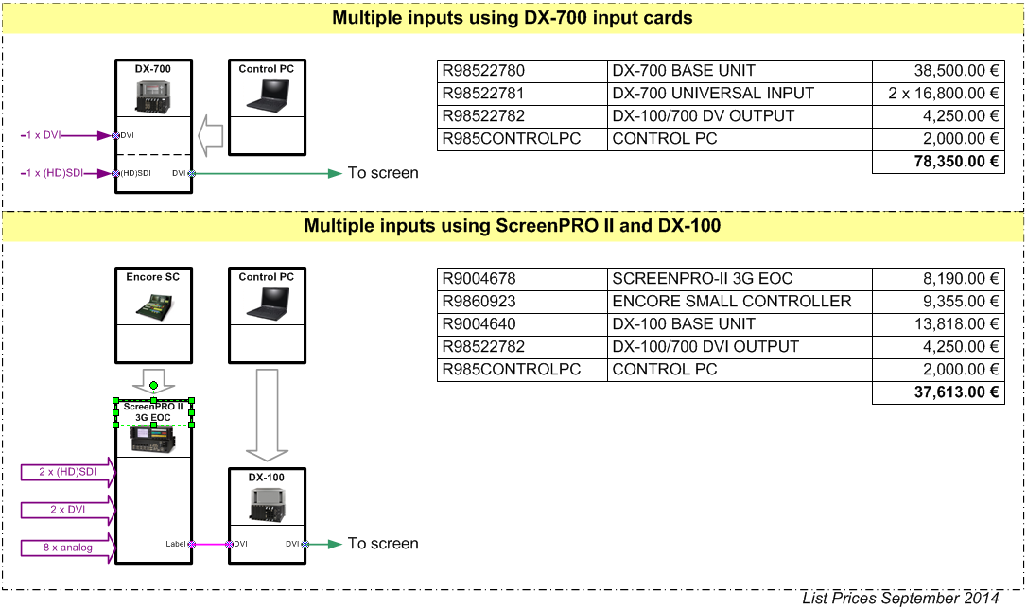
Image processing: Combining multiple inputs to one screen
For almost half of the price
More inputs to your screen
More control of your inputs
Smoother transitions between inputs

Slide 34
Image processing: Practical example -> Scoreboard
PiP allows overlay
Video effects available
Multiple inputs available

Slide 35


Thanks for your Attention
Questions & Answers

